Slide 1
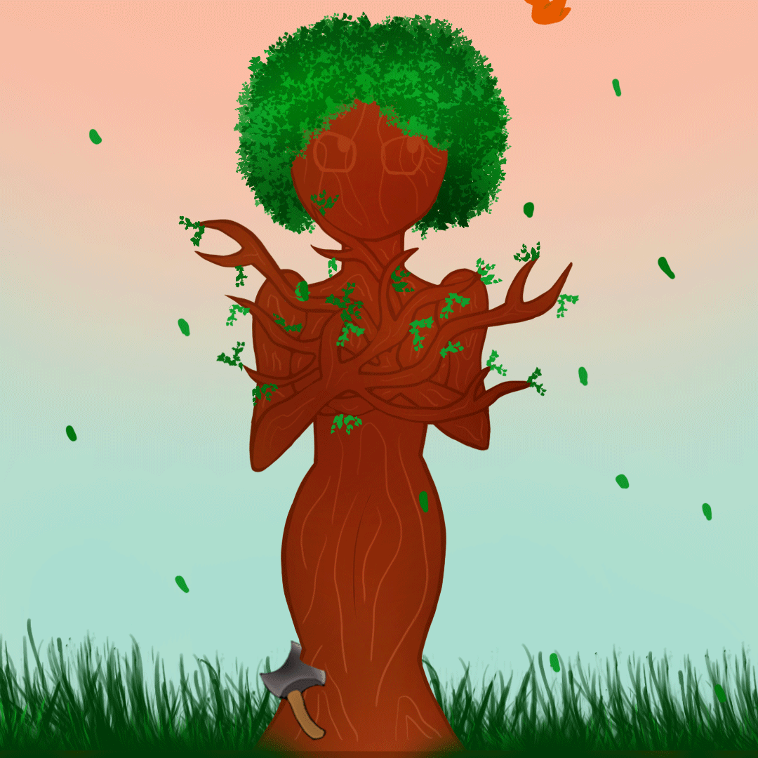
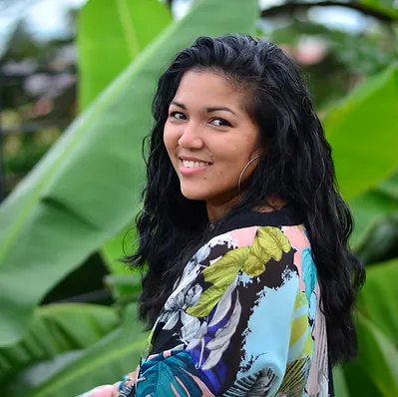
Laboratory Design
Facilitator
Danielle Boodoo Fortune
WomenSpeak
Ecopoetry Workshop
November 18, 2023
Ajoupa Gardens
9am to 1.30pm
$375

